Slide 1
Helen Ruffin Reading Bowl
2017-2018 Season

Slide 2
HRRB at Brandon
9th year competing
4th and 5th grade students
Ms. Waddell, Ms. Brown, & Mrs. Ingram
Meet in the media center
Thursdays
3:00 – 4:00
Team of ten students
Team Shirt

Slide 3
Try outs!
Team selected: Date TBD
‘Top 10’ Readers Based on the following criteria:
Read as many books as you can
AR Quiz score
Turn in 10 Questions per book!
Attendance
Questions answered/competitiveness

Slide 4
Competitions
District Level:
Compete against other APS schools
Location: TBD
Saturday, January 27
9am – 12:30pm
Regional Level:
Compete against other school districts
Clayton State Univ., Morrow, GA
Date TBD
Morning – Time TBD

Slide 5
Competitions
Divisionals:
Compete against other districts
Location TBD
Saturday, February TBD
Morning – Time TBD
State Finals:
Compete against other school in the state
University of GA
Saturday, March TBD
Morning – Time TBD

Slide 6
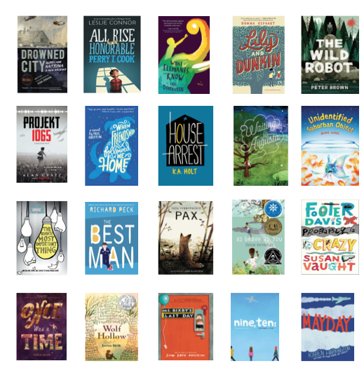
Book List – 20 Titles!

Slide 7
Competition Procedures
At the competitions….
We will participate in 6 rounds.
Each round will consist of 10 questions.
5 players each round (we will switch out players every round – you won’t compete in all 6 rounds…unless you’re on a roll! ☺).
Teams will receive 10 points for each correct answer.
There are no penalties for wrong answers.

Slide 8
Competition Rules
Buzzer (you can hold it during the round you are in)
When you buzz in, the judge will call on you before you answer.
10 seconds to answer.
If the answer is incorrect, the other team will get a chance to answer the question.
If you buzz in before the question is finished being asked, the judge will stop and you have to answer.
If you have a question or concern during a round, you must tell Ms. Waddell or Ms. Richards and we will tell the judges.

Slide 9
Sample Questions
Q: What is the mystery letter that
is on the back of Ali’s mom’s torn photograph?
A: “T” pg. 2
Q: What is the name of the book that Emma likes to be read from frequently?
A: The Lonely Doll pg. 9
Q: What was Sissy wearing when she first met Ali and Emma, and consistently wears throughout the book?
A: Her faded blue bathing suit pg. 38

